Slide 1
Image Processing and Pattern Recognition (IPPR):
(Lecture 2)

Slide 2
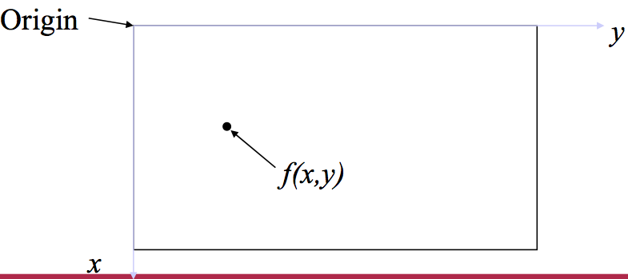
Digital image representation
Monochrome image (or simply image) refers to a 2- dimensional light intensity function f(x,y)
– x and y denote spatial coordinates
– the value of f(x,y) at (x,y) is proportional to the brightness (or gray level) of the image at that point

Slide 3
Digital image representation
A digital image is an image f(x,y) that has been discretized both in spatial coordinates and in brightness
• Considered as a matrix whose row and column indices represent a point in the image
• The corresponding matrix element value represents the gray level at that point
• The elements of such an array are referred to as: – image elements
– picture elements (pixels or pels)

Slide 4
Steps in image processing
Step 1: image acquisition
– Acquire a digital image using an image sensor
• a line-scan camera: produces a single image line at a time, motion past the camera produces a 2-dimensional image
– If not digital, an analog-to-digital conversion process is required
– The nature of the image sensor (and the produced image) are determined by the application

Slide 5
Steps in image processing
• Step 2: preprocessing
– Key function: improve the image in ways that increase the chance for success of the other processes
– may deal with contrast enhancement, removing noise, and isolating regions whose texture indicates a likelihood of alphanumeric information

Slide 6
Steps in image processing
• Step 3: segmentation
– Broadly defined: breaking an image into its constituent parts
– In general, one of the most difficult tasks in image processing
• Good segmentation simplifies the rest of the problem
• Poor segmentation make the task impossible
– Output is usually raw pixel data: may represent region boundaries, points in the region itself, etc.
• Boundary representation can be useful when the focus is on external shape characteristics (e.g. corners, rounded edges, etc.)
• Region representation is appropriate when the focus is on internal properties (e.g. texture or skeletal shape)

Slide 7
Steps in image processing
• Step 4: representation & description
– Representation: transforming raw data into a form
suitable for computer processing
– Description (also called feature extraction) deals with extracting features that result in some quantitative information of interest or features which are basic for differentiating one class of objects from another

Slide 8
Steps in image processing
• Step 5: recognition & interpretation
– Recognition: The process which assigns a label to an object based on the information provided by its descriptors
A may be the alphanumeric character A
– Interpretation: Assigning meaning to an ensemble of recognized objects
35487-0286 may be a ZIP code

Slide 9
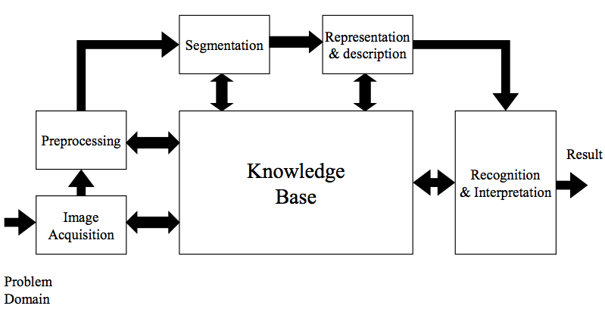
Steps in image processing

Slide 10
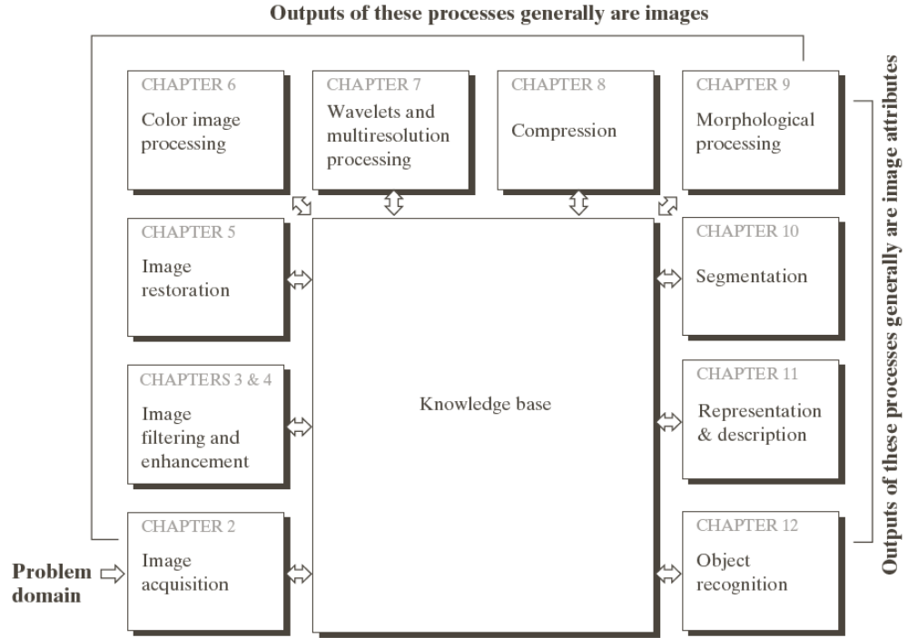
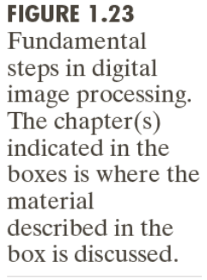
Steps in image processing

Slide 11
A Knowledge Base
• Knowledge about a problem domain is coded into an image processing system in the form of a knowledge database
– Guides operation of each processing module
– Controls interaction between modules
– Provides feedback through the system

Slide 12
Steps in an image processing system
• Not all image processing systems would require all steps/processing modules
– Image enhancement for human visual perception may not go beyond the preprocessing stage
• A knowledge database may not be required
• Processing systems which include recognition and interpretation are associated with image analysis systems in which the objective is autonomous (or at least partially automatic)

Slide 13
A simple imaging model
• An image is a 2-D light intensity function f(x,y)
• As light is a form of energy
0 < f(x,y) < ∞
• f(x,y) may be expressed as the product of 2 components f(x,y)=i(x,y)r(x,y)
• i(x,y) is the illumination: 0 < i(x,y) < ∞
– Typical values: 9000 foot-candles sunny day, 100 office room, 0.01 moonlight
• r(x,y) is the reflectance: 0 < r(x,y) < 1
– r(x,y)=0 implies total absorption
– r(x,y)=1 implies total reflectance
– Typical values: 0.01 black velvet, 0.80 flat white paint, 0.93 snow

Slide 14
A simple imaging model
• The intensity of a monochrome image f at (x,y) is the gray level (l) of the image at that point
• In practice Lmin=imin rmin and Lmax=imax rmax
• As a guideline Lmin ≈ 0.005 and Lmax ≈ 100 for indoor image processing applications
• The interval [Lmin, Lmax] is called the gray scale
• Common practice is to shift the interval to [0,L] where l=0 is considered black and l=L is considered white. All intermediate values are shades of gray

Slide 15

Sampling and Quantization
• To be suitable for computer processing an image, f(x,y) must be digitized both spatially and in amplitude
• Digitizing the spatial coordinates is called image sampling
• Amplitude digitization is called gray-level quantization
• f(x,y) is approximated by equally spaced samples in the form of an NxM array where each element is a discrete quantity

Slide 16
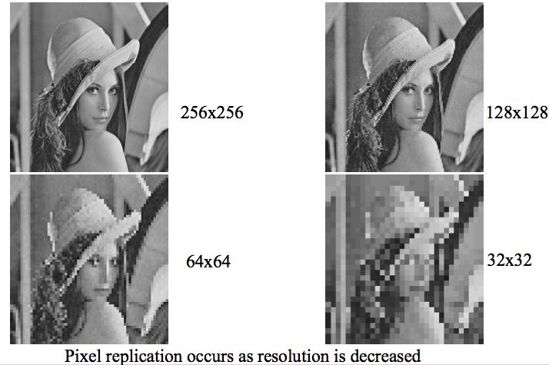
Effects of reducing spatial resolution

Slide 17
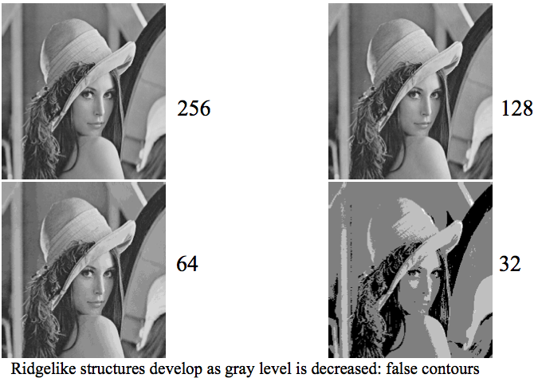
Effects of reducing gray levels

Slide 18
Basic relationships between pixels
An image is denoted by: f(x,y)
Lowercase letters (e.g. p, q) will denote individual pixels
A subset of f(x,y) is denoted by S
Neighbors of a pixel:
– A pixel p at (x,y) has 4 horizontal/vertical neighbors at
• (x+1,y),(x-1,y),(x,y+1)and(x,y-1)
• called the 4-neighbors of p: N4(p)
– A pixel p at (x,y) has 4 diagonal neighbors at
• (x+1,y+1),(x+1,y-1),(x-1,y+1)and(x-1,y-1)
• called the diagonal–neighbors of p:ND(p)
– The 4-neighbors and the diagonal-neighbors of p are called the 8-neighbors of p: N8(p)

Slide 19

Connectivity between pixels
• Connectivity is an important concept in establishing boundaries of object and components of regions in an image
• When are two pixels connected?
– If they are adjacent in some sense (say they are 4-neighbors)
– and, if their gray levels satisfy a specified criterion of similarity (say they are equal)
• Example: given a binary image (e.g. gray scale = [0,1]), two pixels may be 4-neighbors but are not considered connected unless they have the same value

Slide 20
Connectivity between pixels
• Let V be the set of values used to determine connectivity
– For example, in a binary image, V={1} for the connectivity of pixels
with a value of 1
– In a gray scale image, for the connectivity of pixels with a range of
intensity values of, say, 32 to 64, it follows that V={32,33,...,63,64}
– Consider three types of connectivity
• 4-connectivity: Pixels p and q with values from V are 4-connected if q is in the set N4(p)
• 8-connectivity: Pixels p and q with values from V are 8-connected if q is in the set N8(p)
• m-connectivity (mixed): Pixels p and q with values from V are
m-connected if
– q is in the set N4(p),or
– q is in the set ND(p) and the set N4(p) ∩ N4(q) is empty (This is the set of pixels that are 4-neighbors of p and q and whose values are from V)

Slide 21


Distance measures
• Given pixels p, q, and z at (x,y), (s,t) and (u,v) respectively,
• D is a distance function (or metric) if:
– D(p,q) ≥ 0 (D(p,q)=0 iff p=q),
– D(p,q) = D(q,p), and
– D(p,z) ≤ D(p,q) + D(q,z).
• The Euclidean distance between p and q is given by:
• The D4 distance (also called the city block distance) between p and q is given by:

Slide 22
Distance measures
• The D8 distance (also called the chessboard distance) between p and q is given by:

Slide 23
Arithmetic & logic operations
• Arithmetic & logic operations on images used extensively in most image processing applications
– May cover the entire image or a subset Arithmetic operation between pixels p and q are defined as:
– Addition: (p+q)
• Used often for image averaging to reduce noise
– Subtraction: (p-q)
• Used often for static background removal
– Multiplication: (p*q) (or pq, p×q)
• Used to correct gray-level shading
– Division: (p÷q) (or p/q)
• As in multiplication

Slide 24
Logic operations
• Arithmetic operation between pixels p and q are defined as:
– AND: p AND q (also p⋅q)
– OR: p OR q (also p+q)
– COMPLEMENT: NOTq (also q’)
• Form a functionally complete set
• Applicable to binary images
• Basic tools in binary image processing, used for:
– Masking
– Feature detection
– Shape analysis

Slide 25
Neighborhood-oriented operations
• Arithmetic and logical operations may take place on a subset of the image
– Typically neighborhood oriented
• Formulated in the context of mask operations (also
called template, window or filter operations)
• Basic concept:let the value of a pixel be a function of its (current) gray level and the gray level of its neighbors (in some sense)

Slide 26
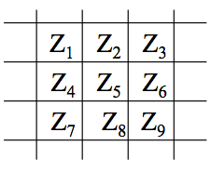

Neighborhood-oriented operations
• Consider the following subset of pixels in an image
• Suppose we want to filter the image by replacing the value at Z5 with the average value of the pixels in a 3x3 region centered around Z5
• Perform an operation of the form:
• and assign to z5 the value of z

Slide 27

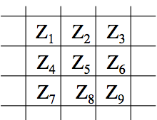
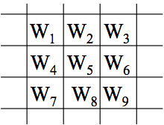
Neighborhood-oriented operations
• In the more general form, the operation may look like:
• This equation is widely used in image processing
• Proper selection of coefficients (weights) allows for operations such as
– noise reduction
– region thinning
– edge detection

Slide 28
What Is Image Enhancement?
Image enhancement is the process of making images more useful
The reasons for doing this include:
  Highlighting interesting detail in images
  Removing noise from images
  Making images more visually appealing

Slide 29
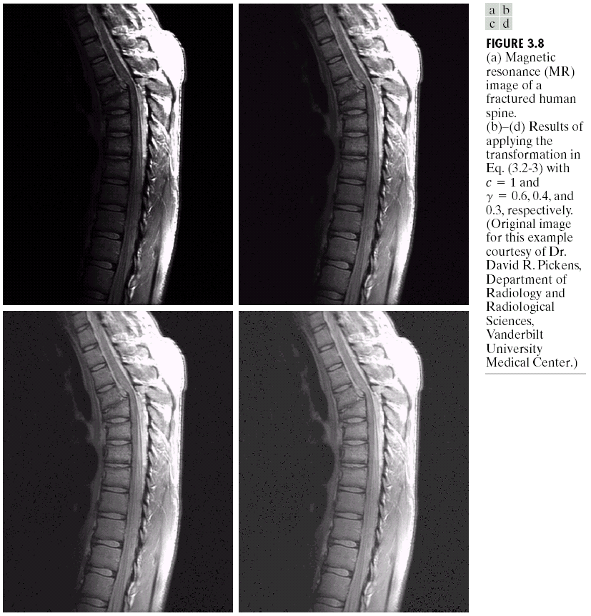
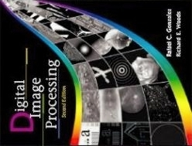
Image Enhancement Examples
Images taken from Gonzalez & Woods, Digital Image Processing (2002)

Slide 30
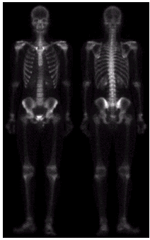
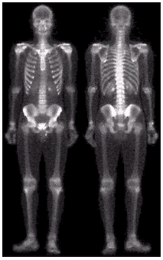
Image Enhancement Examples (cont…)
Images taken from Gonzalez & Woods, Digital Image Processing (2002)

Slide 31

Image Enhancement Examples (cont…)
Images taken from Gonzalez & Woods, Digital Image Processing (2002)

Slide 32
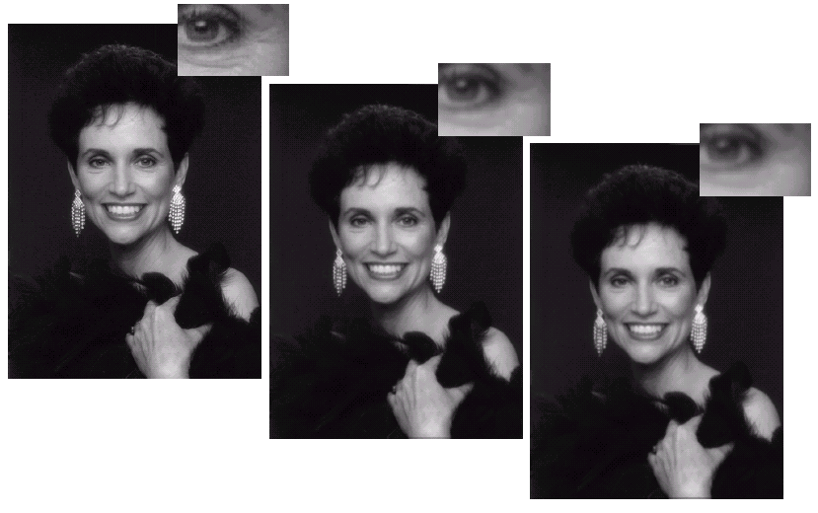
Image Enhancement Examples (cont…)
Images taken from Gonzalez & Woods, Digital Image Processing (2002)

Slide 33
Spatial & Frequency Domains
There are two broad categories of image enhancement techniques
  Spatial domain techniques
    Direct manipulation of image pixels
  Frequency domain techniques
    Manipulation of Fourier transform or wavelet transform of an image
For the moment we will concentrate on techniques that operate in the spatial domain

Slide 34
Basic Spatial Domain Image Enhancement
Most spatial domain enhancement operations can be reduced to the form
g (x, y) = T[ f (x, y)]
where f (x, y) is the
input image, g (x, y) is
the processed image
and T is some
operator defined over
some neighbourhood
of (x, y)
Origin
x
(x, y)
y
Image f (x, y)

Slide 35
Point Processing
The simplest spatial domain operations occur when the neighbourhood is simply the pixel itself
In this case T is referred to as a grey level transformation function or a point processing operation
Point processing operations take the form
s = T ( r )
where s refers to the processed image pixel value and r refers to the original image pixel value

Slide 36
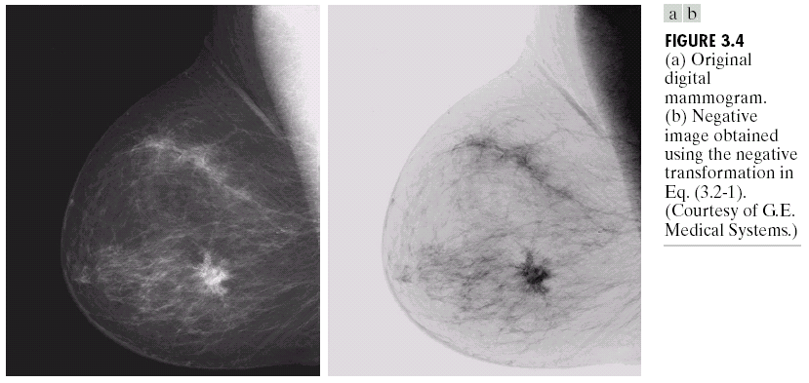
Point Processing Example:
Negative Images
Negative images are useful for enhancing white or grey detail embedded in dark regions of an image
  Note how much clearer the tissue is in the negative image of the mammogram below
Images taken from Gonzalez & Woods, Digital Image Processing (2002)
Original Image
s = 1.0 - r
Negative Image

Slide 37
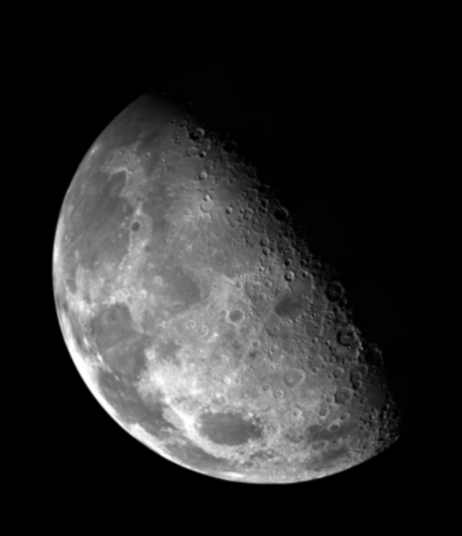

Point Processing Example:
Thresholding
Thresholding transformations are particularly useful for segmentation in which we want to isolate an object of interest from a background
Images taken from Gonzalez & Woods, Digital Image Processing (2002)
1.0
r > threshold
s =
0.0
r <= threshold

Slide 38
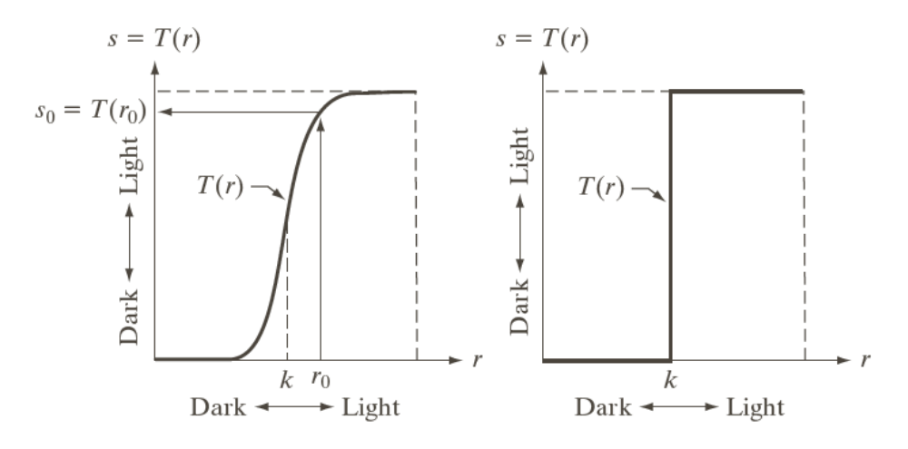
Intensity Transformations
Images taken from Gonzalez & Woods, Digital Image Processing (2002)

Slide 39
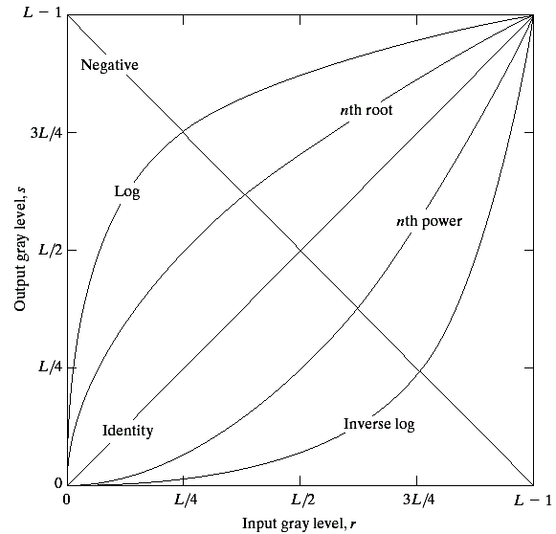
Basic Grey Level Transformations
There are many different kinds of grey level transformations
Three of the most
common are shown
here
  Linear
    Negative/Identity
  Logarithmic
    Log/Inverse log
  Power law
    n^{th} power/n^{th} root
Images taken from Gonzalez & Woods, Digital Image Processing (2002)

Slide 40
Logarithmic Transformations
The general form of the log transformation is
s = c * log(1 + r)
The log transformation maps a narrow range of low input grey level values into a wider range of output values
The inverse log transformation performs the opposite transformation
Compresses the dynamic range of images with large variations in pixel values

Slide 41
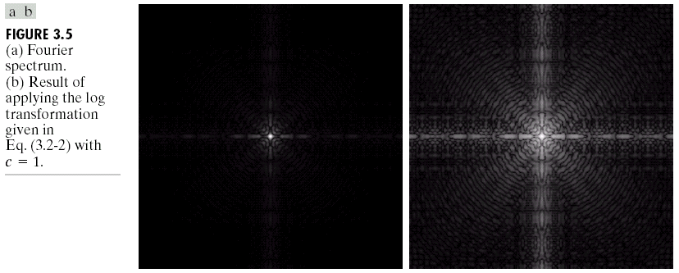
Logarithmic Transformations (cont…)
Images taken from Gonzalez & Woods, Digital Image Processing (2002)
s = log(1 + r)

Slide 42
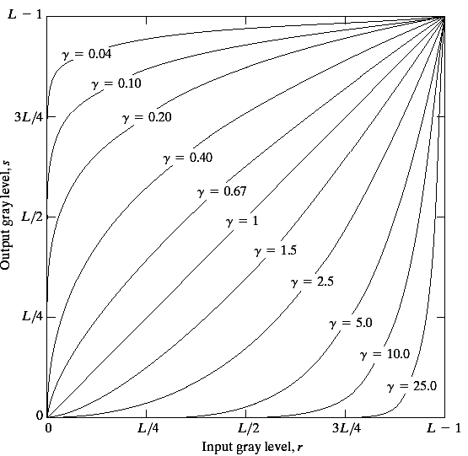
Power Law Transformations
Power law transformations have the following form
s = c * r ^{γ}
Map a narrow range
of dark input values
into a wider range of
output values or vice
versa
Varying γ gives a whole
family of curves
Images taken from Gonzalez & Woods, Digital Image Processing (2002)

Slide 43
Power Law Example

Slide 44
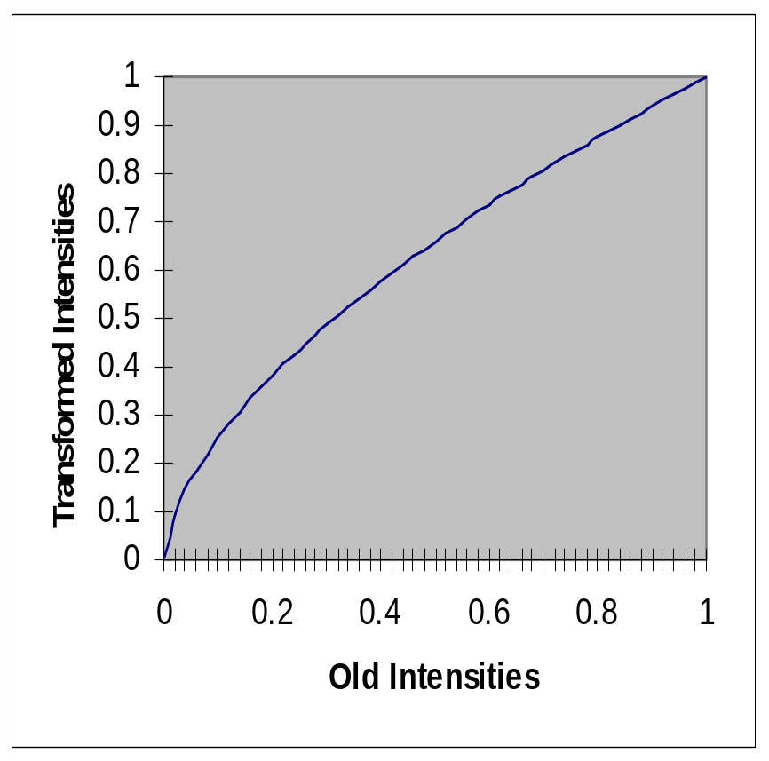
Power Law Example (cont…)
γ = 0.6

Slide 45
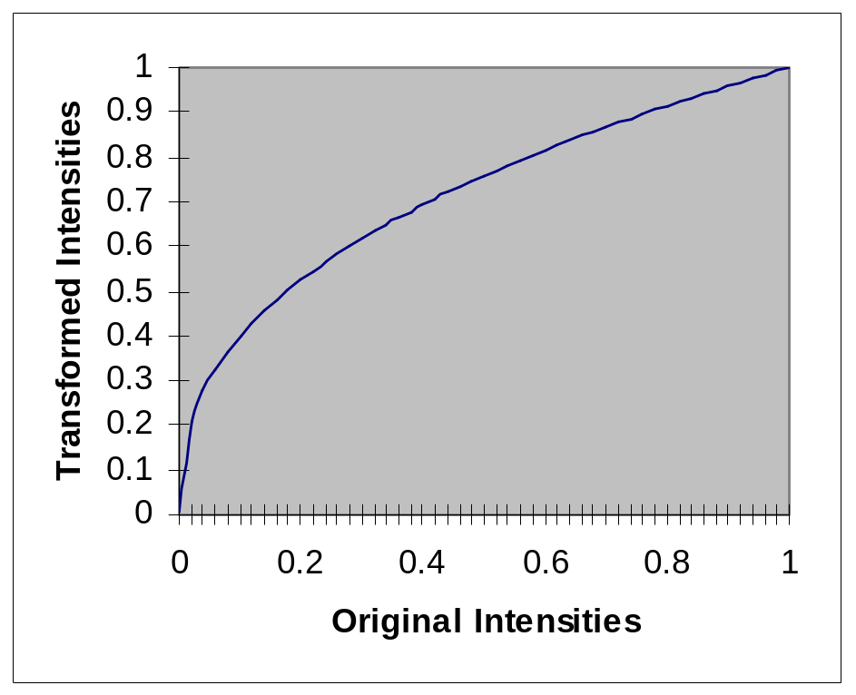
Power Law Example (cont…)
γ = 0.4

Slide 46
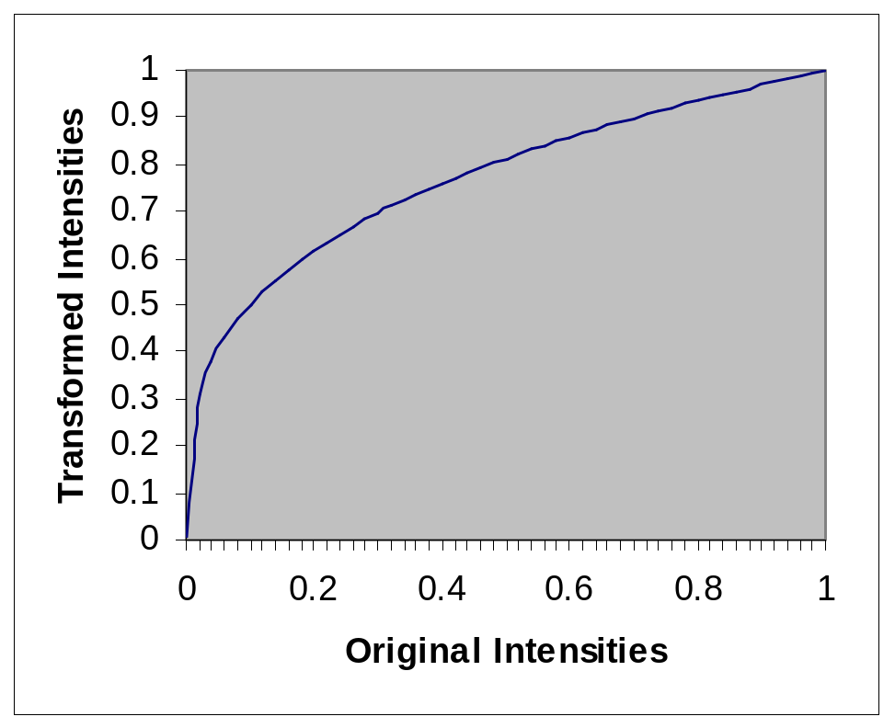
Power Law Example (cont…)
γ = 0.3

Slide 47
Power Law Example (cont…)
The images to the
right show a
magnetic resonance
(MR) image of a
fractured human
spine
Different curves
highlight different
detail
s = r ^{0.6}
s = r ^{0.3}
s = r ^{0.4}
Images taken from Gonzalez & Woods, Digital Image Processing (2002)
Notes:
The third transform is a step too far

Slide 48
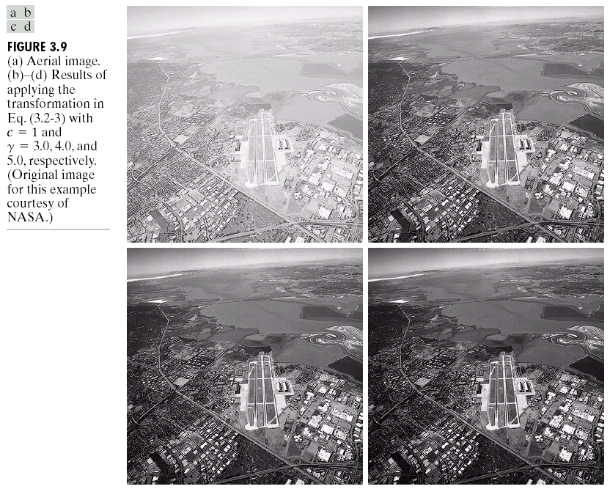
Power Law Example

Slide 49
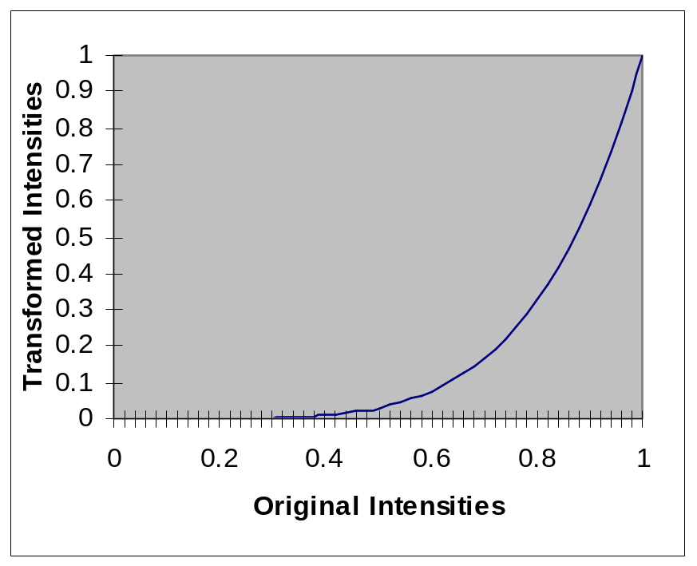
Power Law Example (cont…)
γ = 5.0

Slide 50
Power Law Transformations (cont…)
An aerial photo
of a runway is
shown
This time
power law
transforms are
used to darken
the image
Different curves
highlight
different detail
s = r ^{3.0}
s = r ^{4.0}
s = r ^{5.0}
Images taken from Gonzalez & Woods, Digital Image Processing (2002)

Slide 51

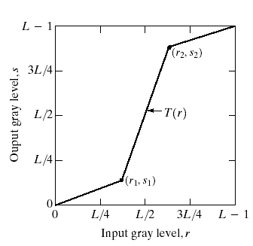
Piecewise Linear Transformation Functions
Rather than using a well defined mathematical function we can use arbitrary user-defined transforms
The images below show a contrast stretching linear transform to add contrast to a poor quality image
Images taken from Gonzalez & Woods, Digital Image Processing (2002)

Slide 52
Piecewise Linear Transformation Functions
• Rather than using a well defined mathematical function we can use arbitrary user-defined transforms
• Contrast stretching expands the range of intensity levels in an image so it spans a given (full) intensity range
• Control points (r1,s1) and (r2,s2) control the shape of the transform T(r)
• r1=r2, s1=0 and s2=L-1 yields a thresholding function
The contrast stretched image shown in the previous slide is obtained using the transformation obtained from the equation of the line having following points
• (r1,s1)=(rmin,0) and (r2, s2)=(rmax,L-1)
Images taken from Gonzalez & Woods, Digital Image Processing (2002)

Slide 53
Gray Level Slicing
• Used to highlight a specific range of intensities in an image that might be of interest
•Two common approaches
– Set all pixel values within a range of interest to one value (white) and all others to another value (black)
Produces a binary image
– Brighten (or darken) pixel values in a range of interest and leave all others unchanged
Images taken from Gonzalez & Woods, Digital Image Processing (2002)

Slide 54
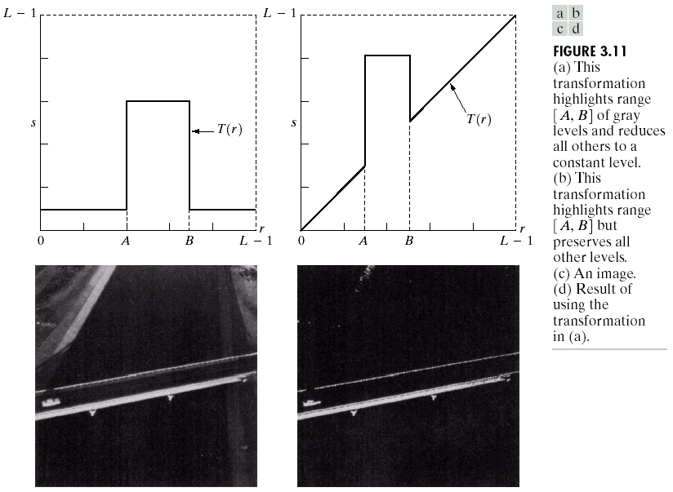
Gray Level Slicing
Highlights a specific range of grey levels
  Similar to thresholding
  Other levels can be
  suppressed or maintained
  Useful for highlighting features
  in an image
Images taken from Gonzalez & Woods, Digital Image Processing (2002)

Slide 55
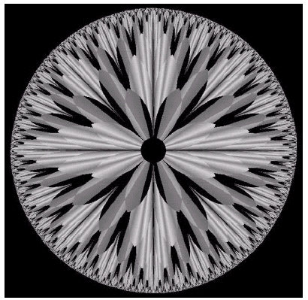
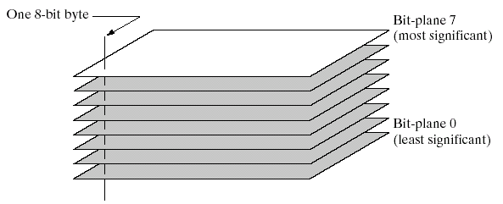
Bit Plane Slicing
Often by isolating particular bits of the pixel values in an image we can highlight interesting aspects of that image
  Higher-order bits usually contain most of the significant visual information
  Lower-order bits contain
  subtle details
Images taken from Gonzalez & Woods, Digital Image Processing (2002)

Slide 56
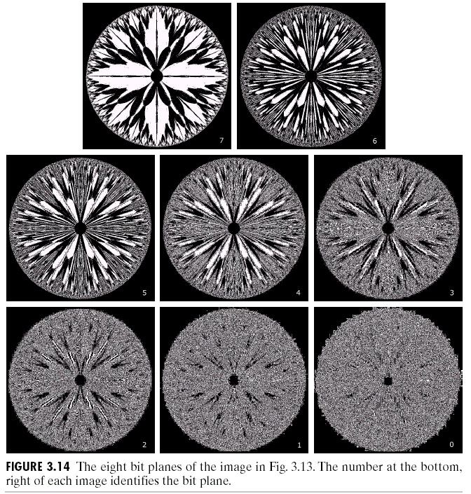
Bit Plane Slicing (cont…)
[10000000]
[01000000]
[00100000]
[00001000]
Images taken from Gonzalez & Woods, Digital Image Processing (2002)
[00000100]
[00000001]

Slide 57
Bit Plane Slicing (cont…)
[10000000]
[01000000]
[00100000]
[00001000]
Images taken from Gonzalez & Woods, Digital Image Processing (2002)
[00000100]
[00000001]

